Slide 1
Media and Fonts
CTEC 130

Slide 2
Media

Slide 3
The History of Media on the Web
Video playback relied on plugins provided by different vendors
Microsoft Silverlight and Macromedia Flash
These plugins were often out-of-date and insecure
With HTML5, many interactive features were pulled into HTML to eliminate the need for plugins
Now most web content is built with HTML5, CSS and JS

Slide 4
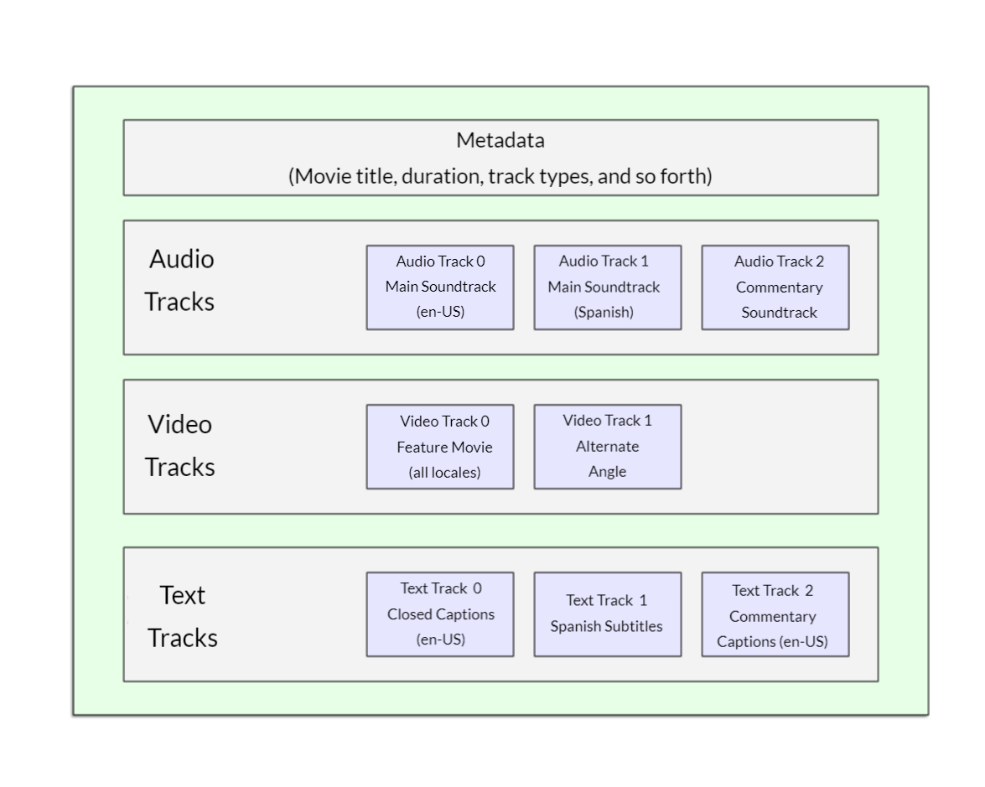
Video Codecs
A video file type and video encoding type aren’t always the same things
File types are “containers” for different video and audio formats
For web, we’ll mostly work with .webm containers, though many browsers also support .mp4
Further notes on video encoding and containers is outside the scope of this course

Slide 5
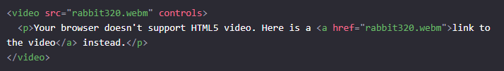
<video></video>
Attributes
src - points to the content to display
controls - a boolean attribute that displays video controls
Content
You can write content inside of the <video> tag, which will display if the user’s browser can’t display the video

Slide 6
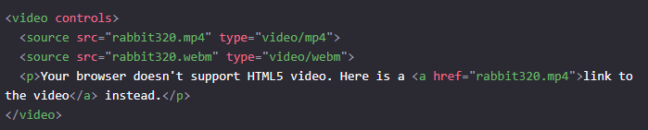
Managing Different Video Sources

Slide 7
Other <video> Attributes
width and height
autoplay - boolean attribute which sets the video to play automatically when loaded
Please note - auto-playing audio when a user loads a page should be a crime
loop - boolean attribute which sets the video to loop playback when completed
muted - boolean attribute which mutes the audio by default
poster - displays an image over the video before it plays, kind of like the “thumbnail” of the video
Set this to a url of an image
preload - sets how the file is loaded
“none” - no buffering applied
“auto” - buffers the file
“metadata” - preloads the metadata only

Slide 8
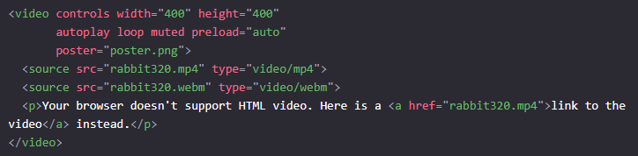
More Options

Slide 9
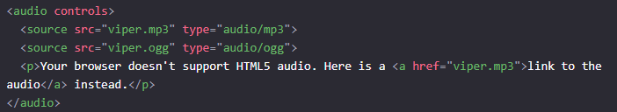
Audio
Works mostly like Video, except it doesn’t support the following
Width
Height
Poster

Slide 10
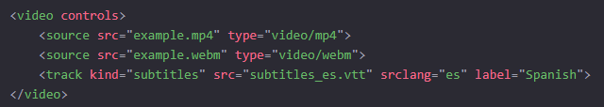
Adding Captions to Videos
The <track> tag can be added inside of a <video> to provide subtitle information
Subtitle files should be stored in vtt format
This is a text format with specific formatting rules that are outside of this class
Many media providers will provide subtitles in this format
Use the kind attribute to set the type of subtitle:
“subtitles,” “captions” or “descriptions”
Use the srclang attribute to specify the language

Slide 11
Web Fonts

Slide 12
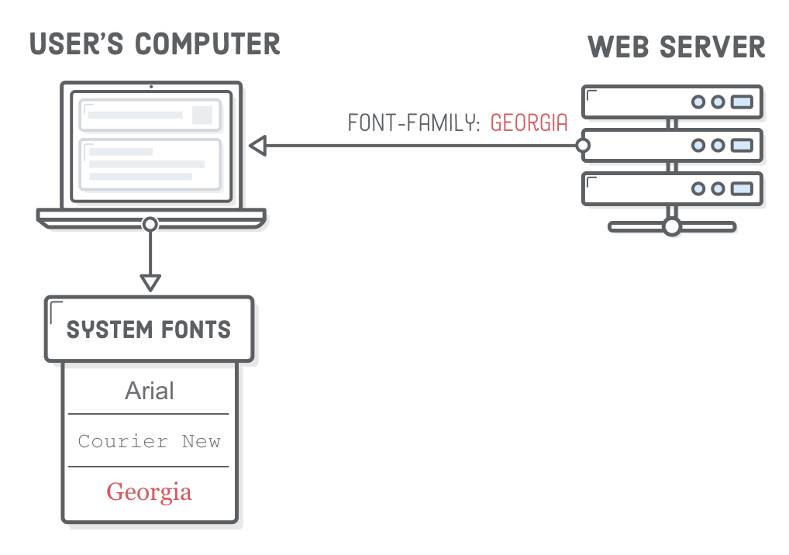
Using Fonts
With the tools we currently have, we can only use a font if it’s already installed on a user’s computer
This is why our font-family takes in multiple fonts; so we have back-ups if they don’t have the one we want to use
There is another way…

Slide 13

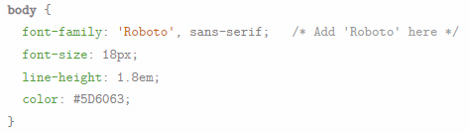
Loading Remote Fonts
We can use @font-face to load a font from a url
After this, we can set fonts in our document to utilize the defined font

Slide 14
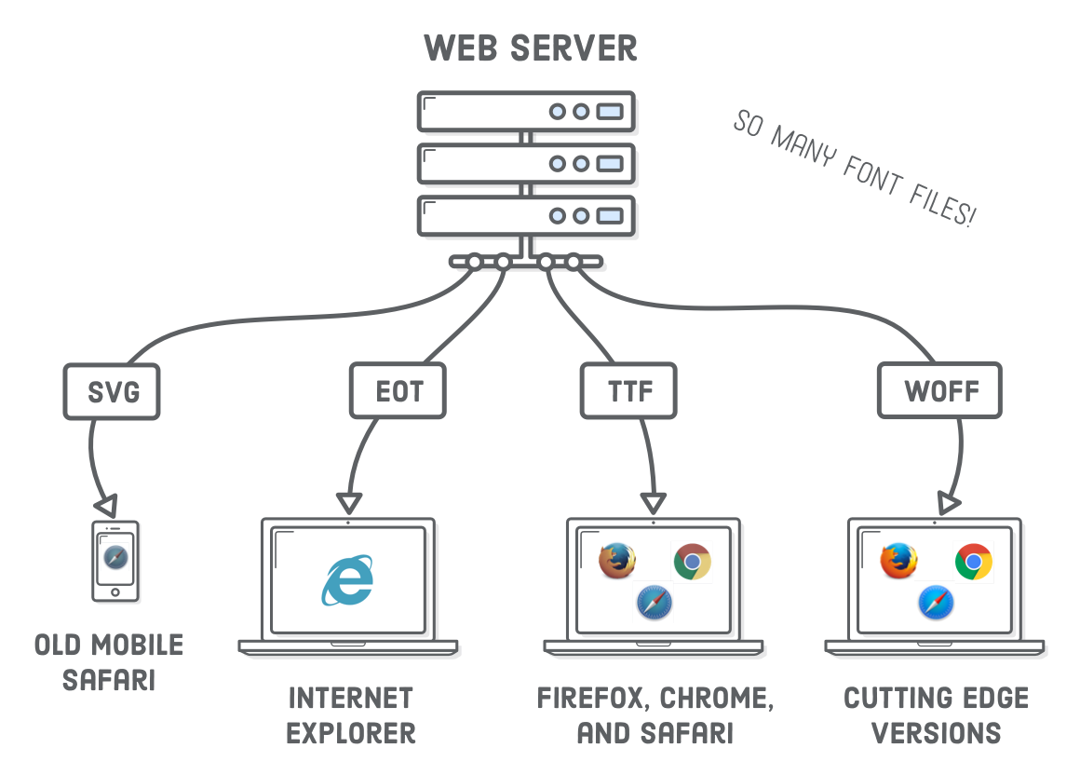
Types of Fonts

Slide 15
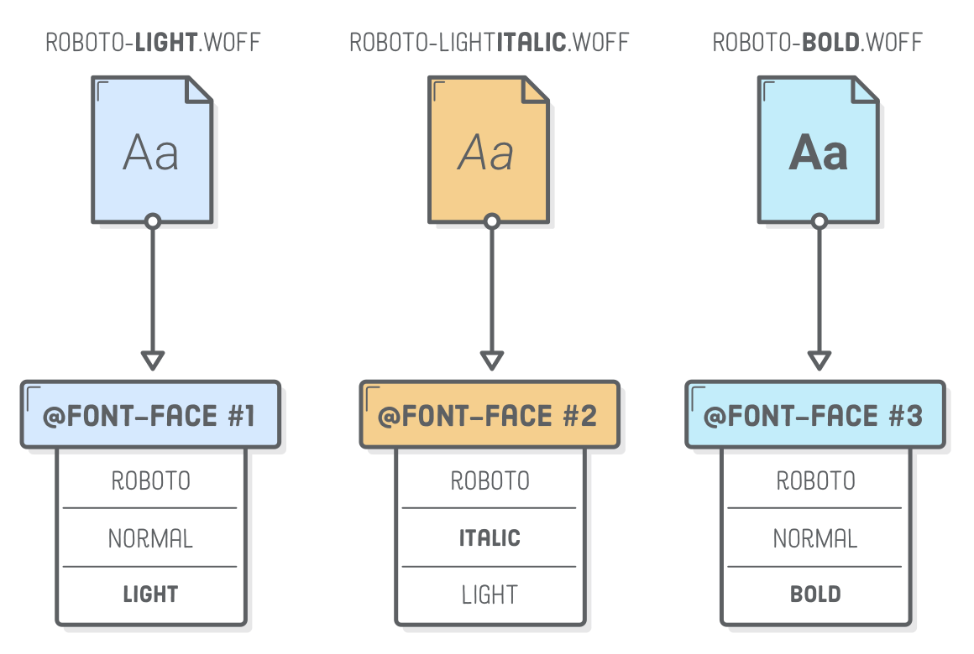
Web Font Limitations
Some web fonts will have separately listed normal, bold and italic versions
You’ll have to import all necessary fonts for different styles
Each font needs its own @font-face definition, though you should specify the same name with a different style for each one

Slide 16
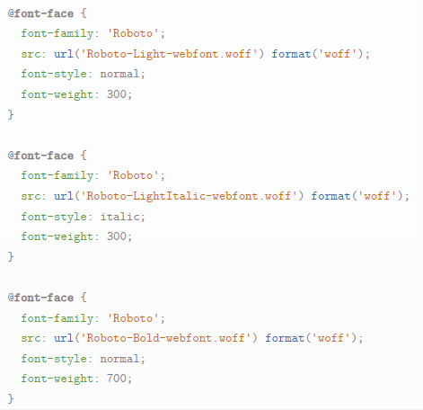

Slide 17
Avoiding the Hard Parts with Online Font Libraries
You only have to worry about most of this stuff when you’re serving a font yourself
You should also make sure you have the legal rights to upload and share it
Online font libraries will provide their own CSS links you can use that set up @font-face for you
This does take font control away from you, as the font will go away if they ever decide to take it down

Slide 18
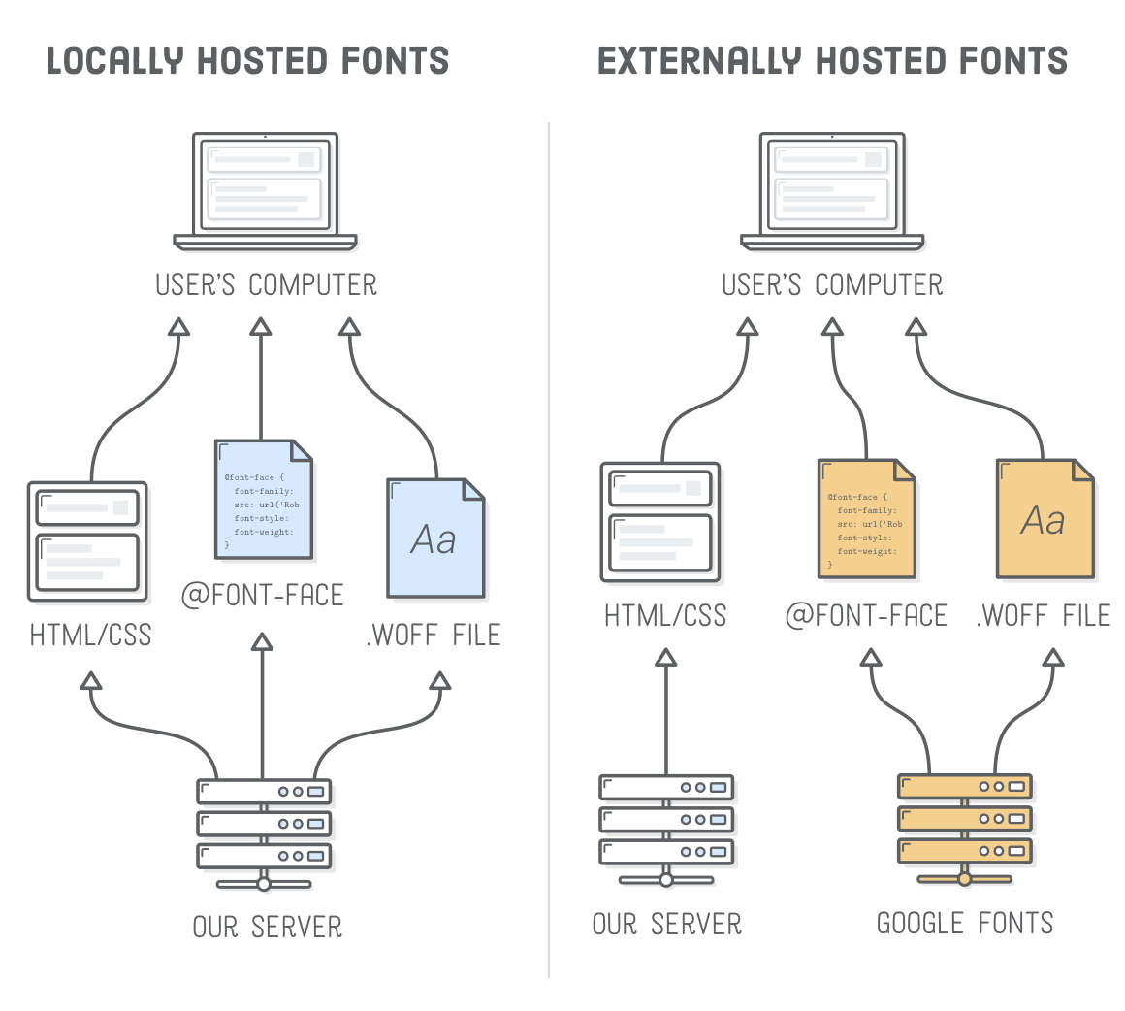

Slide 19
Let’s try out Google Fonts

Slide 20
Print CSS

Slide 21
Design for Print
At some point, someone will want to print out your website
What looks good on screen may not look good on paper
White text on black background
No worries, we can define CSS styles that only apply for print

Slide 22
Creating a Separate Stylesheet

Slide 23
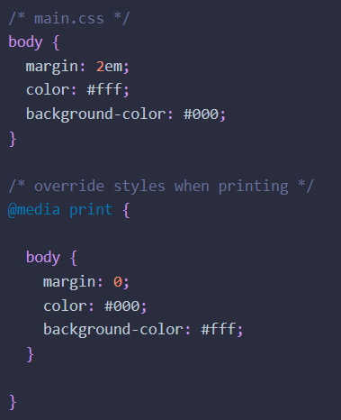
Using Media Queries

